Slide 1
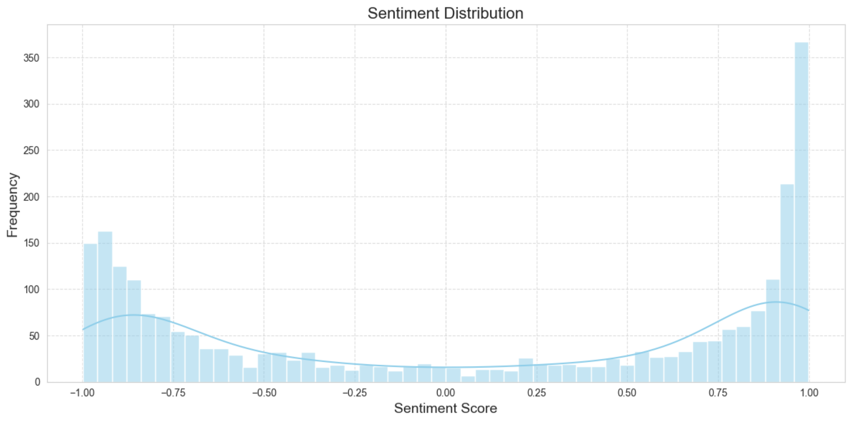
Targeted Improvement Plan
"does not value their customers"
"felt misguided and misinformed"
"a surprisingly good flight"
"cheap and sleazy budget airline"
"absolutely great"
"service was totally unacceptable"
"thoroughly recommend it"
"my luggage arrived soaking wet"
"the worst experience ever"
"a really lovely flight"
"Very rude and unhelpful staff"
"style and attention to detail"
"left me extremely disappointed"
"cabin crew were excellent"
"atrocious customer service"
"cabin crew excelled throughout "
"This was a great flight"
Negative Reviews
Positive Reviews

Slide 2
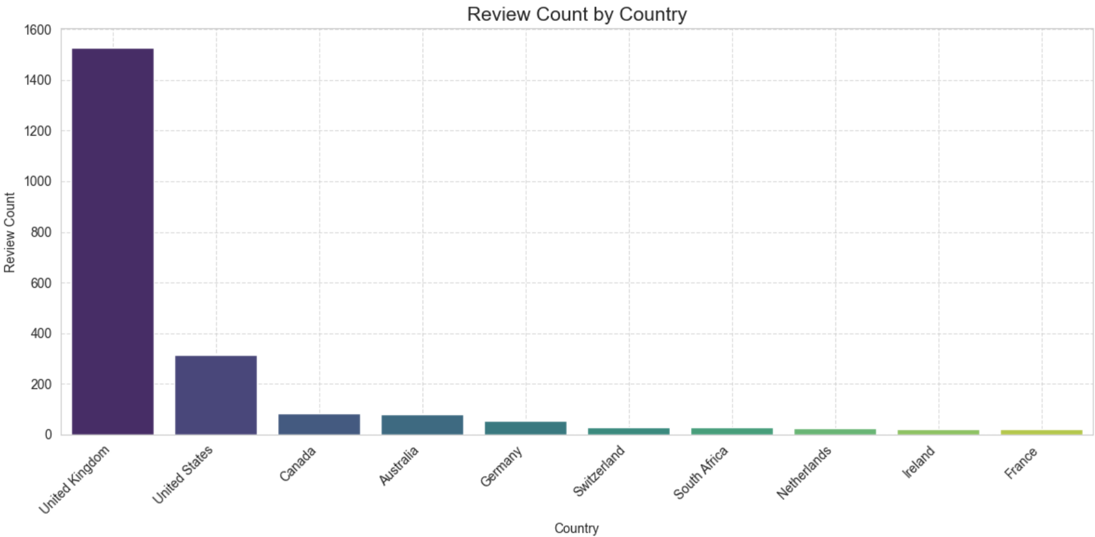
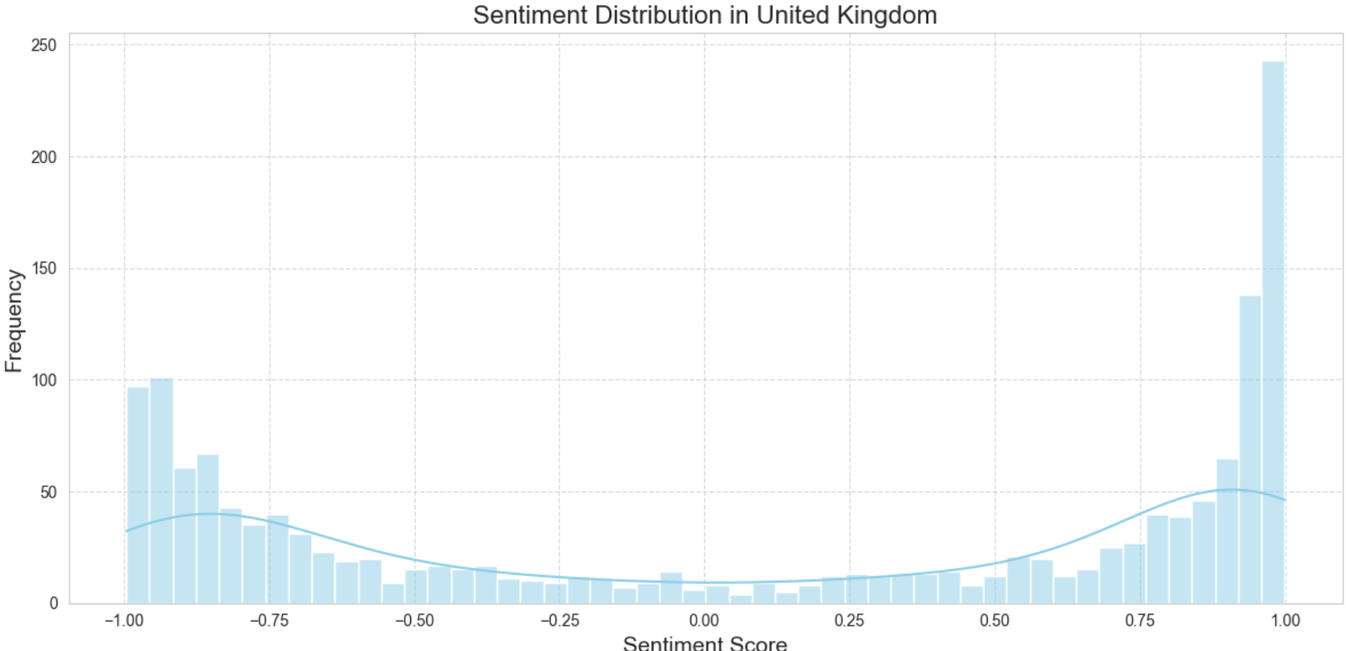
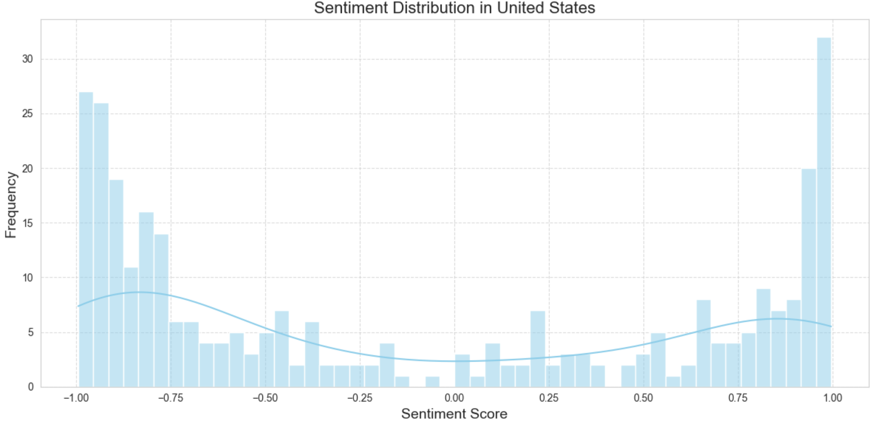
Highest concentration of customers: UK & US
Sentiment analysis shows UK users negative reviews -> Nearly 30% of all reviews
US users negative reviews -> 7% of all reviews

